Slide 1
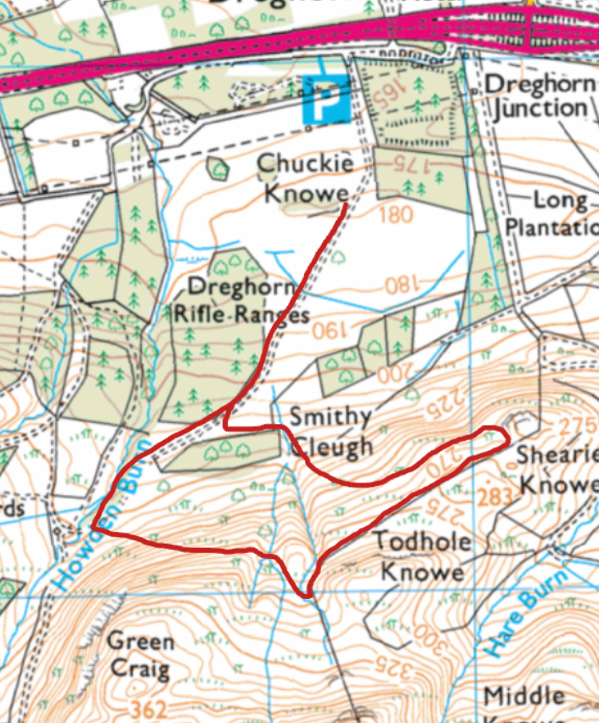
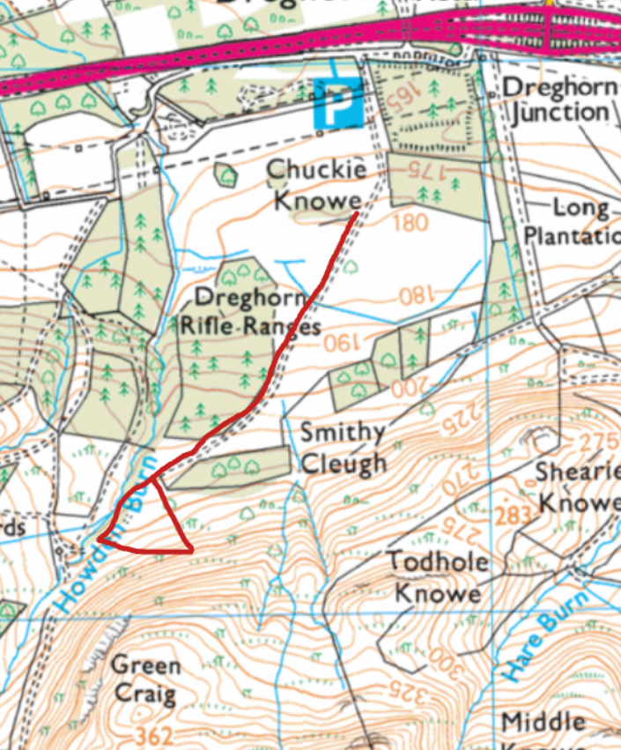
Junior Race: S/F, A, B, C, D, E, A, S/F.
2 Miles, 400ft. 3.2km, 125m
Fun Run: S/F, A, B, C, A, S/F.
1 Miles, 230ft. 1.6km, 70m
S/F
S/F
A
E
A
B
B
C
C
D

